Slide 1
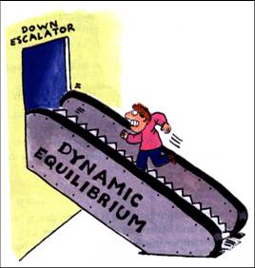
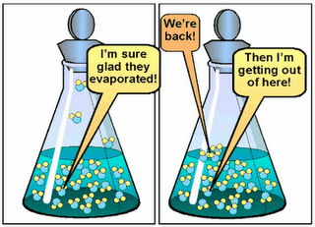
Reversible reactions
Chemical equilibrium
ATAR Chemistry Unit 3 2021

Slide 2
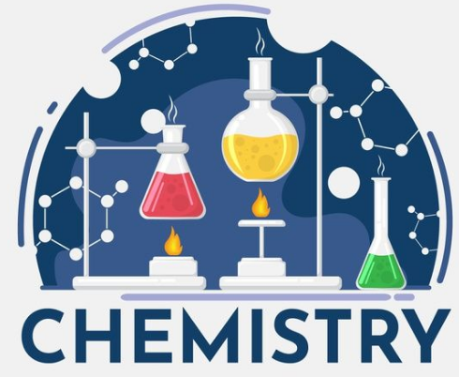
Outline
Reversible reactions
Physical equilibrium
Chemical equilibrium
Resources:
Essential chem chap 2.1 – 2.3, Set 2 Q 1-5
STAWA

Slide 3
Recall – strong and weak acids
Acids have been described as either strong or weak based on their conductivity (as electrolytes), which shows the amount of ions present in solution to enable a current to be carried.
Eg Hydrochloric acid is strong while ethanoic acid is weak
HCl_{(aq)} + H₂O_{(l)} H₃O⁺_{(aq)} + Cl⁻_{(aq)}
CH₃COOH_{(aq)} + H₂O_{(l)} H₃O⁺_{(aq)} + CH₃COO⁻_{(aq)}
We show the strong acid as only going in the forward direction, compared to the weak acid which can go forward and backwards

Slide 4
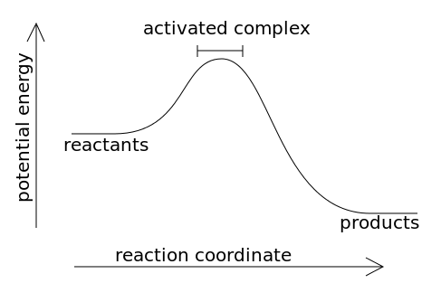
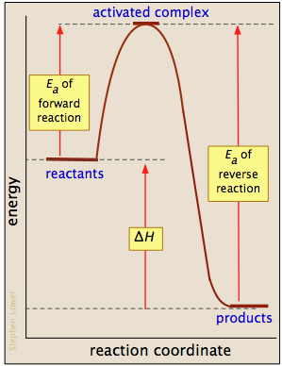
Reversible reactions
We can more clearly see the distinction if we consider the energy profile diagram for the two processes.
The Ea of forward reaction is less then Ea of reverse reaction
This can make the reverse reaction negligible to the point that we ignore it
This example the Ea for forward and reverse reactions is relatively small, so the reaction can proceed significantly in either direction

Slide 5
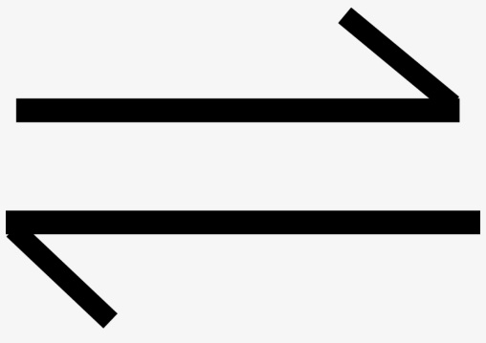
Reversible reactions
Most chemical reactions and physical processes are reversible to some extent
Reversible reactions will never go to completion (i.e. they never give 100 % product) as the competing reverse reaction is always reforming reactants.
Reversible reactions and processes are represented by a double arrow
We are going to explore physical equilibrium and chemical equilibrium as well as what happens when the system is changed (e.g. temperature is increased or concentration of one specie is changed)

Slide 6
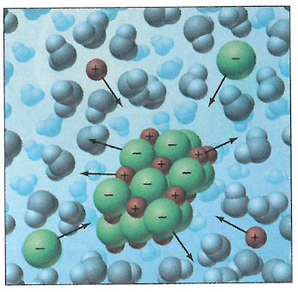
Physical equilibrium
Open system – system where matter and energy to enter and/or leave the system
Closed system – system where only energy can enter or leave the system
Physical equilibrium we can explore phases changes and solution equilibria (solid dissolving and precipitating from a solution)

Slide 7

Physical equilibrium
Closed system so no vapour can escape
Start: very little vapour in the flask, evaporation rate will be high
Overtime: as concentration of vapour increases the evaporation rate will slow but at the same time the condensation will begin to increase.
Dynamic equilibrium: the point at which the rate of condensation equals the rate of evaporation. The amount of water liquid and water vapour is now steady. This results in a constant vapour pressure that we call the equilibrium vapour pressure

Slide 8
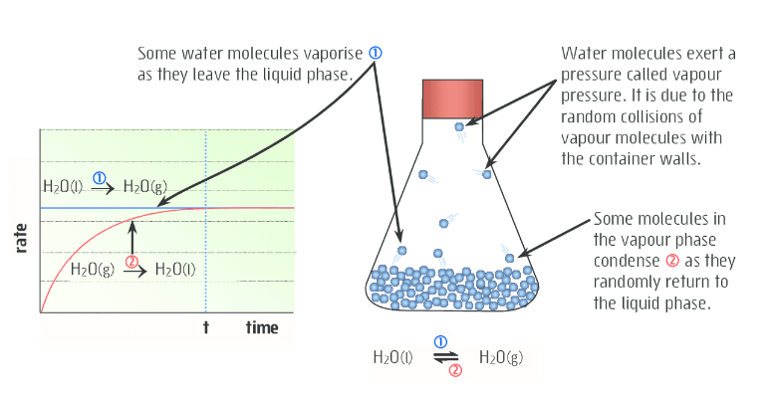
Physical equilibrium

Slide 9
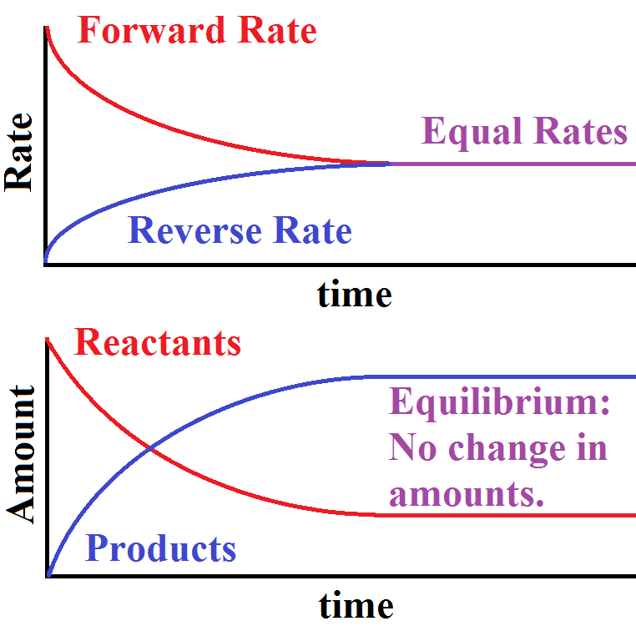
Physical equilibrium
We are now graphing rate vs time, rather than amount vs time
See in both graphs when you reach the steady state you are in equilibrium **WACE ALERT** if your equilibrium section is not straight you will lose marks

Slide 10
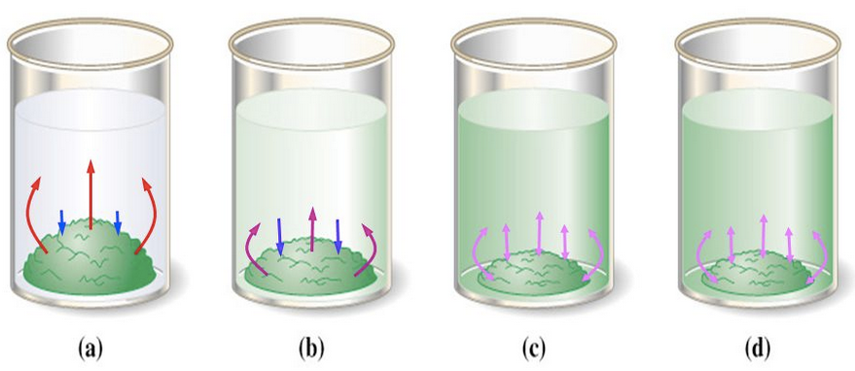
Physical equilibrium
Saturated Solutions:
In a saturated solution, an equilibrium exists between a small piece of excess solute and the solution. For a given temperature, the number of solute particles dissolving equals the number recrystallising.

Slide 11
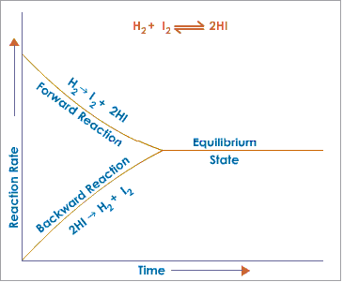
Chemical equilibrium
For reactions that do not go to completion a dynamic equilibrium exists where the forward and reverse reactions are ongoing.
For reactions starting with just the reactants the forward and reverse reaction rates will vary and change till they meet equilibrium.
In equilibrium the macro physical properties are not seen to change. Eg colours, concentrations etc

Slide 12
Chemical equilibrium
When equilibrium is reached the macroscopic properties of the system become constant, this included concentration of reactants and products, pressure, colour, temperature.
This does NOT mean it is a static system, it is important to remember that both the forward and reverse reaction are still occur but are perfectly balanced – for this reason we say equilibriums are dynamic.

Slide 13

Chemical equilibrium
Nitrogen dioxide / Dinitrogen tetraoxide system
Forward reaction is exothermic, and the reverse reaction is endothermic.
Watch the demo in class to see what happens when you change the conditions of an equilibrium system

Slide 14
Chemical equilibrium
Nitrogen dioxide / Dinitrogen tetraoxide system
The effect of temperature:
https://www.youtube.com/watch?v=oC3klPMRnwo
https://www.youtube.com/watch?v=ScWBj0hqOLE
The effect of pressure:
https://www.youtube.com/watch?v=L6GfhqoCz8Y

